Slide 1
Recommendation System
8th Aug 2019
Kuan Sao I

Slide 2
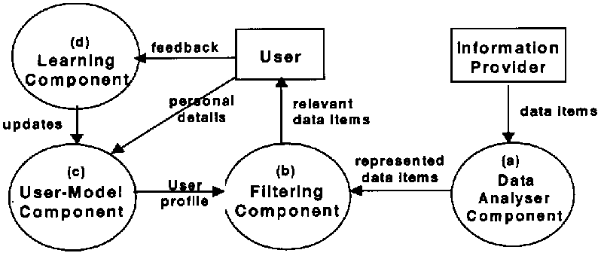
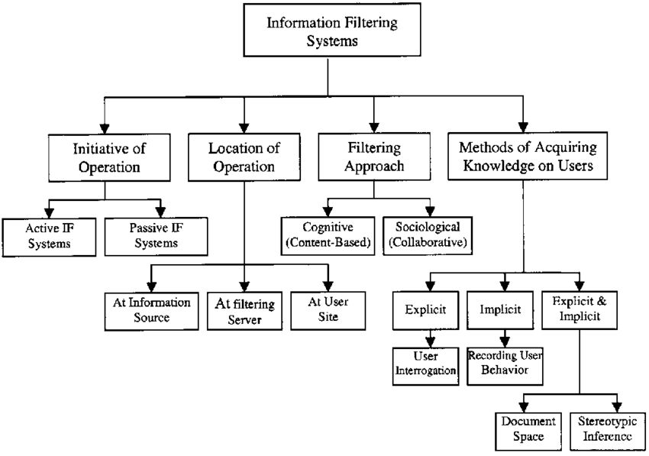
Information Filtering(IF)
Subset of information filtering system:
information filtering(IF) is method for delivery of relevant information.
The filtering component (b)
The heart of the IF system:
matches the user profile with the represented data items and decides if a data item is relevant to the user.
Notes:
Information Filtering: Overview of Issues, Research and Systems

Slide 3
RS-Challenge-Diversity
When the task is to recommend items which are likely to be appreciated by a particular user, it is usually most effective to recommend popular and highly rated items.
Such recommendation, however, has very little value for the users because popular objects are easy to find (often they are even hard to avoid) without a recommender system.
A good list of recommended items hence should contain also less obvious items that are unlikely to be reached by the users themselves.
Approaches to this problem include direct enhancement of the recommendation list’s diversity and the use of hybrid recommendation methods.
Notes:
[26]-Recommender Systems

Slide 4
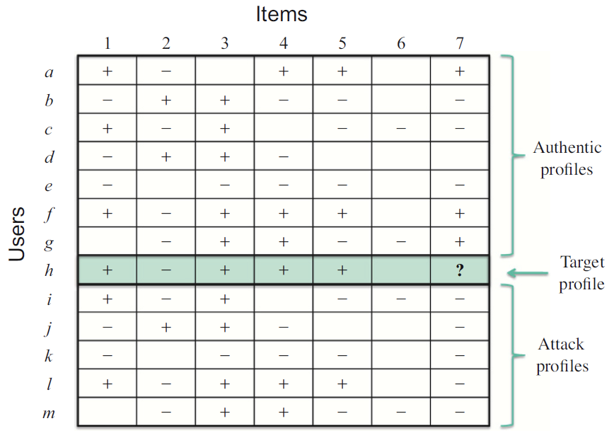
RS-Challenge- Vulnerability to attacks.
Due to their importance in e-commerce applications, recommender systems are likely targets of malicious attacks trying to unjustly promote or inhibit some items.
Shilling attacks:
4 classes
8 methods
Notes:
[26]-Recommender Systems

Slide 5
RS-Challenge- Vulnerability to attacks.
A profile-injection attack against a recommender system consists of a set of profiles added to the system by the attacker.
For the attacks that we are discussing, there will always be a target item it that the attacker is interested in promoting or demoting.
Basic Attacks
Random Attack
Average Attack
Low-knowledge attacks
Bandwagon Attack
Segment Attack
Nuke Attack Models
Love/Hate Attack
Reverse Bandwagon Attack
Informed Attack Models
Popular Attack
Probe Attack Strategy
Notes:
[26]-Recommender Systems
https://dslab.epfl.ch/people/zamfir/widm2005.pdf
Preventing Shilling Attacks in Online Recommender Systems

Slide 6
Basic Attacks
Random Attack
Average Attack
Random attack profiles consist of random ratings distributed around the overall mean assigned to the filler items and a prespecified rating assigned to the target item.
The target item it is assigned the maximum rating r(max) or the minimum rating r)min) in the case of push or nuke attacks, respectively.
In the average attack, each assigned rating for a filler item corresponds (either exactly or approximately) to the mean rating for that item, across the users in the database who have rated it.
This attack can also be used as a nuke attack by using r(min) instead of r(max). It should also be noted that the only difference between the average attack and the random attack is in the manner in which ratings are computed for the filler items in the profile.

Slide 7
Low-knowledge attacks
Bandwagon Attack
Segment Attack
The goal of the bandwagon attack is to associate the attacked item with a small number of frequently rated items.
This attack takes advantage of the Zipf’s distribution of popularity in consumer markets: a small number of items, bestseller books for example, will receive the lion’s share of attention and also ratings.
The attacker using this model will build attack profiles containing those items that have high visibility.
Such profiles will have a good probability of being similar to a large number of users, since the high visibility items are those that many users have rated.
The bandwagon attack uses selected items which are likely to have been rated by a large number of users in the database.
These items are assigned the maximum rating value together with the target item it .
The basic idea behind the segment attack is to push an item to a targeted group of users with known or easily predicted preferences.
For example, the producer of a horror movie might want to get the movie recommended to viewers who have liked other horror movies. In fact, the producer might prefer not to have his movie recommender to viewer who do not enjoy the horror genre, since these users might complain and thereby reveal his attack.
To mount this attack, the attacker determines a set of segment items that are likely to be preferred by his intended target audience.
Like the bandwagon attack, it is usually fairly easy to predict what the most popular items in a user segment would be.
These items are assigned the maximum rating value together with the target item.

Slide 8
Nuke Attack Models
Love/Hate Attack
Reverse Bandwagon Attack
The love/hate attack is a very simple attack, with no knowledge requirements.
The attack consists of attack profiles in which the target item it is given the minimum rating value, rmin, while other ratings in the filler item set are the maximum rating value, rmax.
This can be seen as a very low-knowledge version of the Popular Attack below.
Surprisingly, this is one of the most effective nuke attacks against the userbased algorithm.
The reverse bandwagon attack is a variation of the bandwagon attack, discussed above, in which the selected items are those that tend to be rated poorly by many users.
These items are assigned low ratings together with the target item.
Thus the target item is associated with widely disliked items, increasing the probability that the system will generate low predicted ratings for that item.
This attack was designed to reduce the knowledge required by selecting only a handful of known disliked items.
For example, in the movie domain, these may be box office flops that had been highly promoted prior to their openings.

Slide 9
Informed Attack Models
Popular Attack
Probe Attack Strategy
Attack profiles are constructed using popular items from the domain under attack.
The Popular Attack makes use of average rating data and rates the filler items either rmin +1 and rmin, according to whether the average rating for the item is higher or lower.
To perform this strategy, the attacker creates a seed profile and then uses it to generate recommendations from the system.
These recommendations are generated by the neighboring users and so they are guaranteed to be rated by at least some of these users and the predicted ratings will be well-correlated with these users’ opinions.
One could imagine probing narrowly in order to influence a small group as in the segment attack, or probing more broadly to construct an average attack.
In a sense, the probe attack provides a way for the attacker to incrementally learn about the system’s rating distribution.

Slide 10
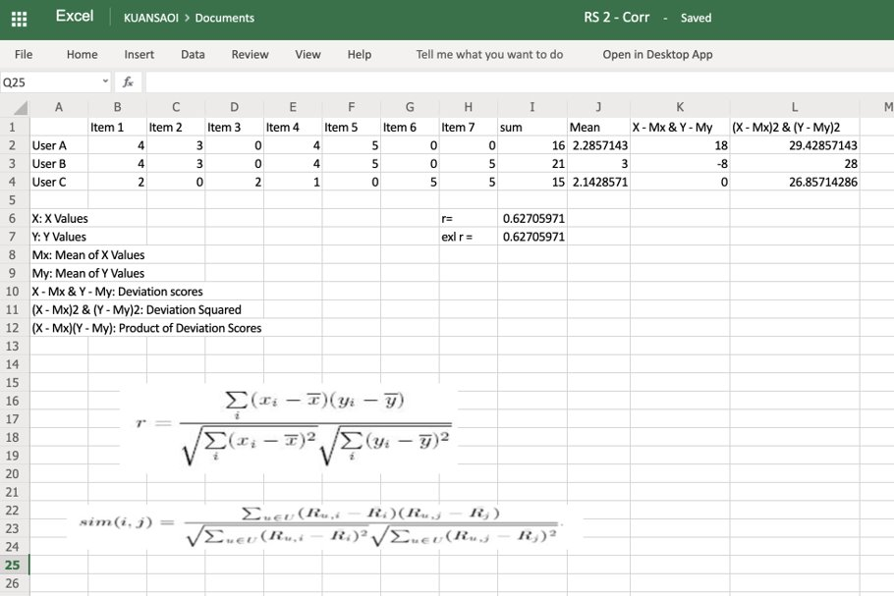
Pearson Correlation Coefficient Calculation
The Pearson correlation coefficient is used to measure the strength of a linear association between two variables, where the value r = 1 means a perfect positive correlation and the value r = -1 means a perfect negataive correlation.
Notes:
https://www.socscistatistics.com/tests/pearson/default2.aspx
https://pukyongackr-my.sharepoint.com/:x:/r/personal/kuansaoi_pukyong_ac_kr/_layouts/15/Doc.aspx?sourcedoc=%7BB37066B6-2746-4C98-B927-2F188FDB7E67%7D&file=Book.xlsx&action=default&mobileredirect=true

Slide 11
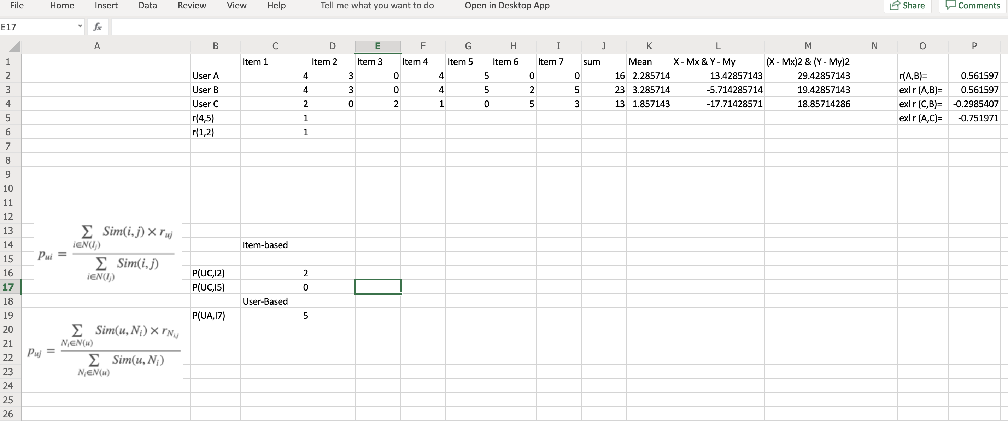
KNN-User/Item-based計錯, 因為0唔計, 睇公式吶! 一齊有GE值先計
Notes:
https://lianhaimiao.github.io/2018/01/06/%E6%8E%A8%E8%8D%90%E7%B3%BB%E7%BB%9F%E6%96%B9%E6%B3%95%E5%B0%8F%E7%BB%93-%E4%B8%8A/
Handbook - bias

Slide 12
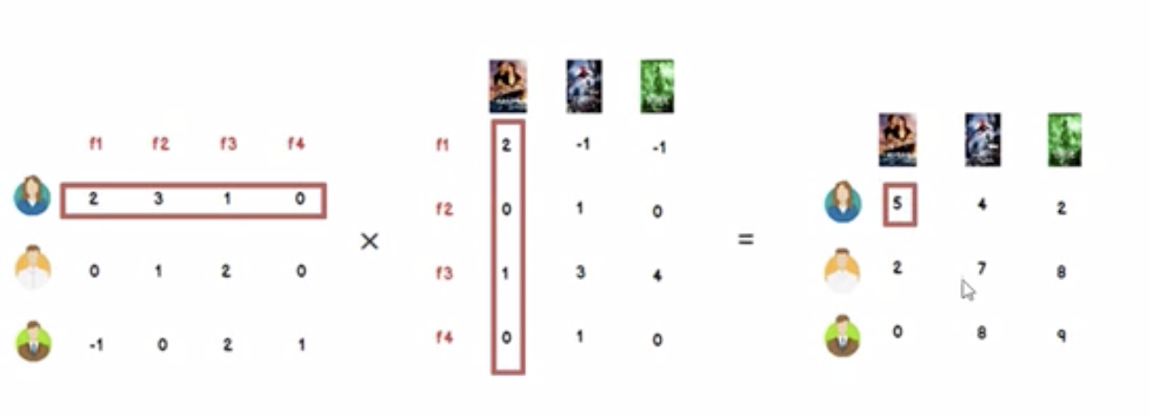
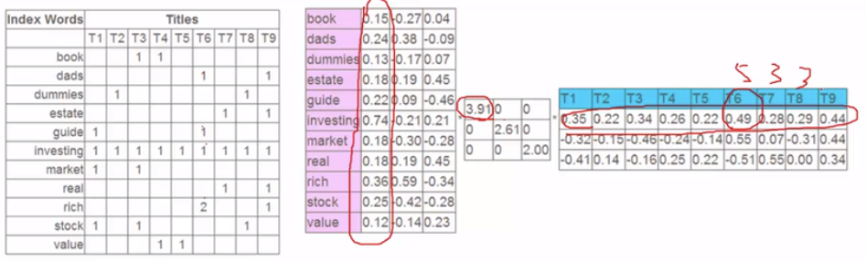
SVD(Singular Value Decomposition)
Notes:
http://www.d.umn.edu/~mhampton/m4326svd_example.pdf
https://fenix.tecnico.ulisboa.pt/downloadFile/3779576344458/singular-value-decomposition-fast-track-tutorial.pdf
http://web.mit.edu/be.400/www/SVD/Singular_Value_Decomposition.htm

Slide 13
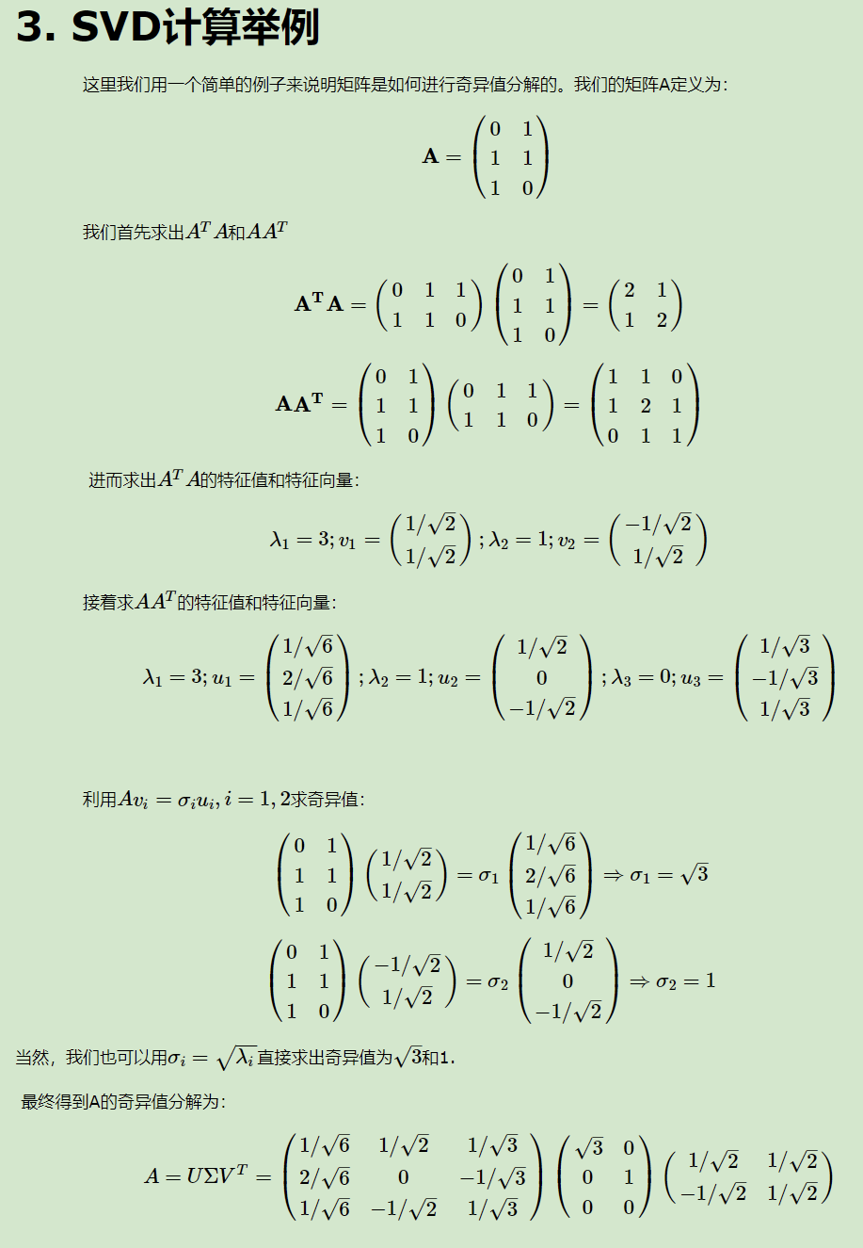
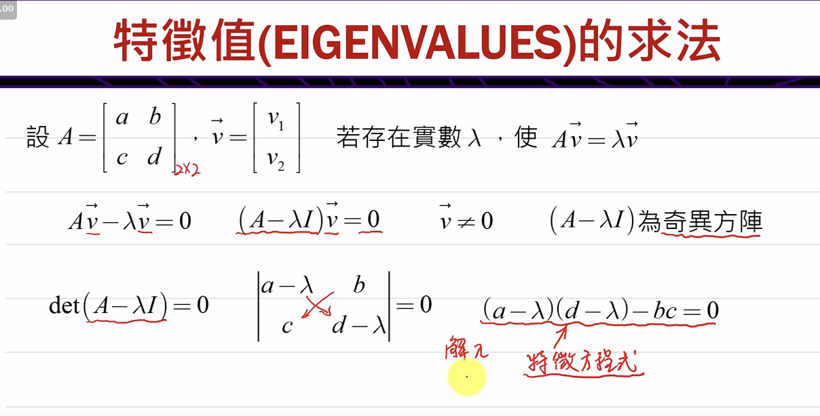
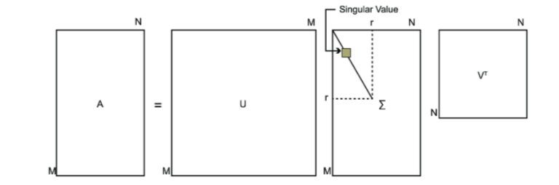
SVD
𝐴𝑥=𝜆𝑥

Slide 14
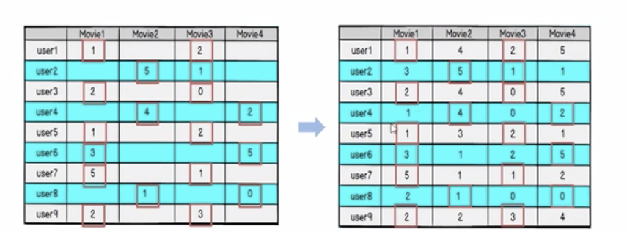
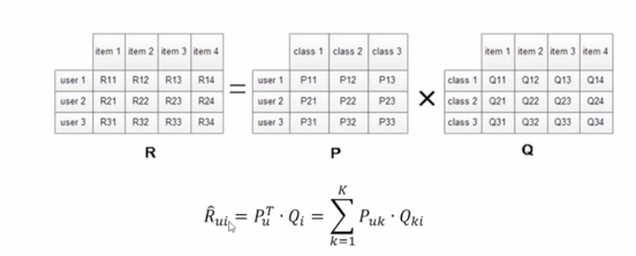
SVD

Slide 15
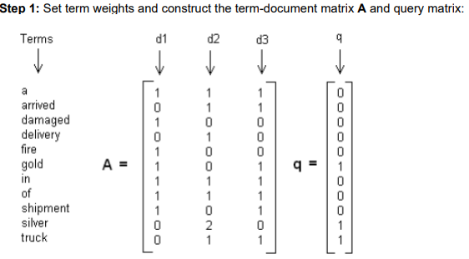
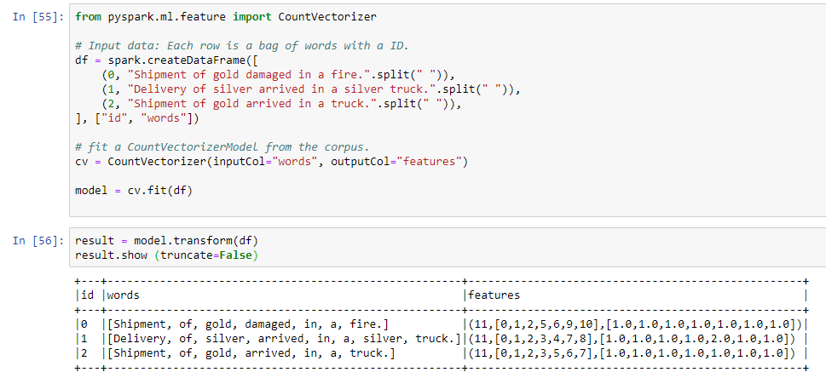
LSI
A “collection” consists of the following “documents”:
d1: Shipment of gold damaged in a fire.
d2: Delivery of silver arrived in a silver truck.
d3: Shipment of gold arrived in a truck.
Notes:
http://www1.se.cuhk.edu.hk/~seem5680/lecture/LSI-Eg.pdf
https://dzone.com/articles/calculating-tf-idf-with-apache-spark

Slide 16
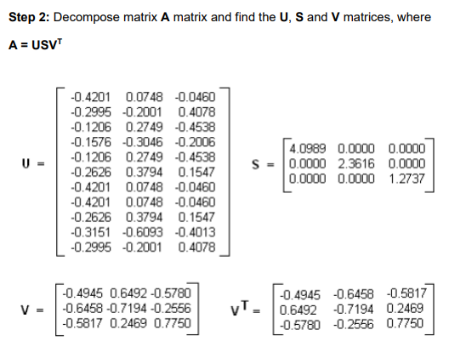
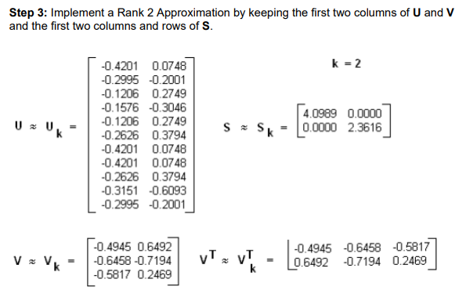
LSI

Slide 17
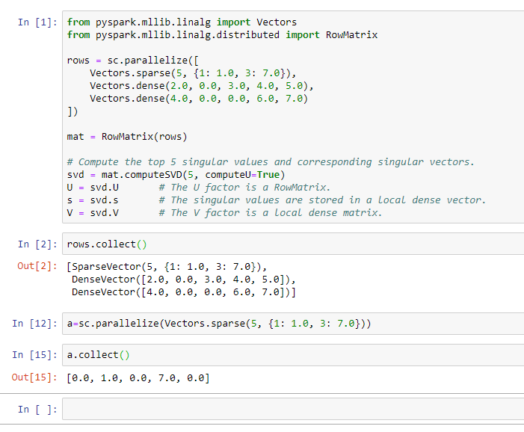
Example of SVD in Pyspark

Slide 18

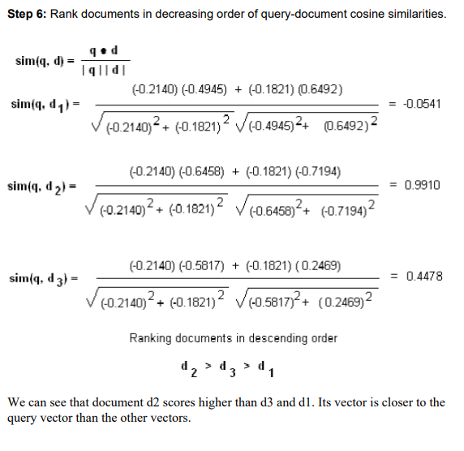
LSI

Slide 19
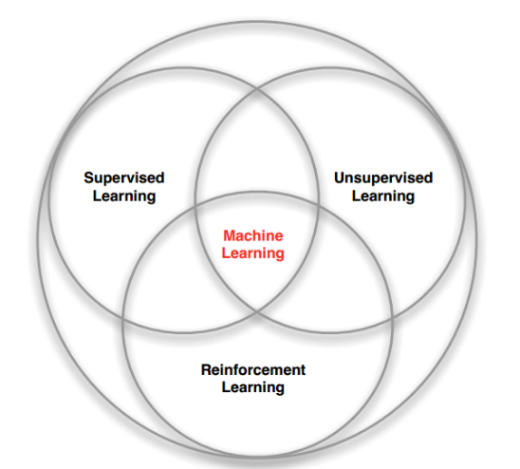
MDP
A reinforcement learning task that satisfies the Markov property is called a Markov decision process, or MDP.
Reinforcement learning is simultaneously a problem, a class of solution methods that work well on the class of problems, and the field that studies these problems and their solution methods.
Reinforcement learning problems involve learning what to do—how to map situations to actions—so as to maximize a numerical reward signal.
Notes:
https://mc.ai/introduction-to-reinforcement-learning/
20-Reinforcement Learning: An Introduction: Richard S. Sutton and Andrew G. Barto
https://web.stanford.edu/class/psych209/Readings/SuttonBartoIPRLBook2ndEd.pdf

Slide 20

MDP
MDP (Markov Decision Process): A probabilistic model of a sequential decision problem, where states can be perceived exactly, and the current state and action selected determine a probability distribution on future states. Essentially, the outcome of applying an action to a state dwpends only on the current action and state (and not on preceding actions or states).
State: A state can be viewed as a summary of the past history of the system, that determines its future evolution.
Reward: A scalar value which represents the degree to which a state or action is desirable. Reward functions can be used to specify a wide range of planning goals (e.g. by penalizing every non-goal state).
Agent: A system embedded in an environment. It performs actions to change the state of the environment. Examples include mobile robots, software agents, or industrial controllers.
Environment: The external system that an agent is ”embedded” in.

Slide 21
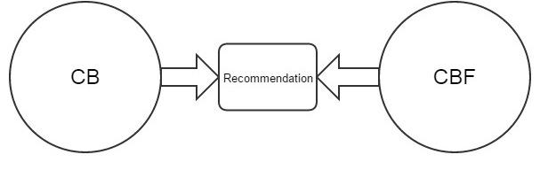
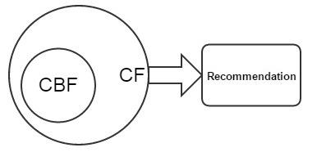
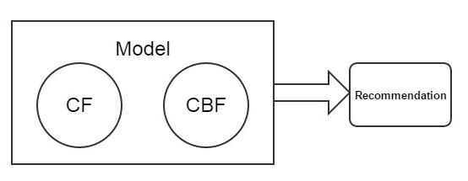
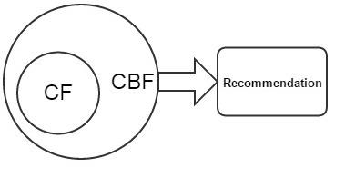
Hybrid Recommendation System
4 ways
7 classes
Weighted
Switching
Mixed
Feature Combination
Feature Augmentation
Cascade
Meta-level

Slide 22
4 ways to implement
Content-based filtering ("cold-start")
Collaborative filtering (accurate recommendations)
Hybrid schemes
Figure 5 shows the methods that incorporate CF characteristics into a CBF approach.
Figure 4 illustrates the methods for construction of a unified utility system with both CBF and CF characteristics.
In this method by combining some features of CBF and CF one unified model is constructed that can improve effectiveness of recommendation process.
Figure 3 shows the methods that integrate CBF characteristics into the CF approach.
So that it will overcome the cold start problem in collaborative filtering and overspecialization problem of content-based filtering.
Figure 2 shows the methods that estimate CBF and CF recommendations individually and subsequently combine them to yield better recommendations across the board.

Slide 23
7 classes of Hybrid RS
Weighted
Different recommendation components scores are combined statistically. This class aggregates scores from each factor using additive formula.
Switching
From available recommendation components system chooses particular component and applies the picked out one.
Mixed
Different recommender provides their recommendation that will be introduced together. This class is based on merging and presentation of multiple rated list into single rated list.
Feature Combination
Contributing and actual recommender are two different recommendation components are exist for this class. The working of actual recommender is depends on the data modified by the contributing one. The contributing one throws features of one source on to the other components source.
Feature Augmentation
This class is similar to the feature combination hybrids but only difference is that the contributor gives novel characteristic. It is more elastic than feature combination method.
Cascade
This class play an role of tie breaker. Here for every recommender assign some priority and according to that assign priority, lower priority recommenders play an tie breakers role over higher priority.
Meta-level
Their exist contributing and actual recommenders but the early one completely substitutes the data for the latter one.
Notes:
https://medium.com/@jockeyng/%E6%B7%B7%E5%90%88%E6%8E%A8%E8%96%A6-hybrid-f9a7de086a7f
混合推薦(Hybrid)
https://lianhaimiao.github.io/2018/01/06/%E6%8E%A8%E8%8D%90%E7%B3%BB%E7%BB%9F%E6%96%B9%E6%B3%95%E5%B0%8F%E7%BB%93-%E4%B8%8A/
推荐系统方法小结(上)
http://b.7dtime.com/B01M7P3GNI/13/1.html
1. 9.2 算法设计层面的混合方法

Slide 24
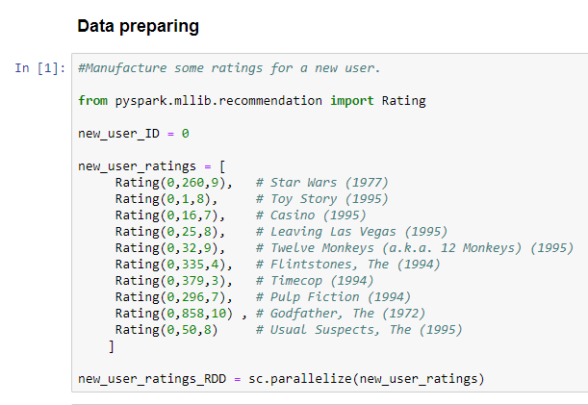
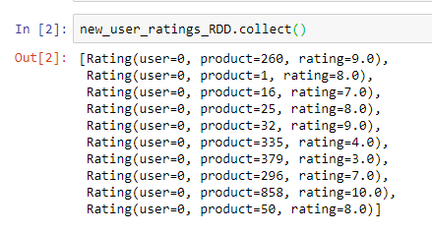
Recommend movies using ALS

Slide 25
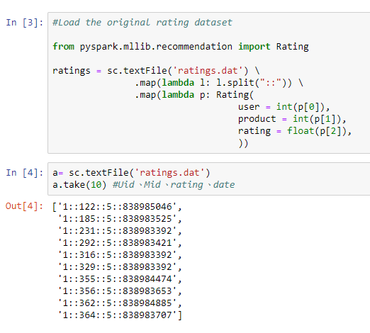
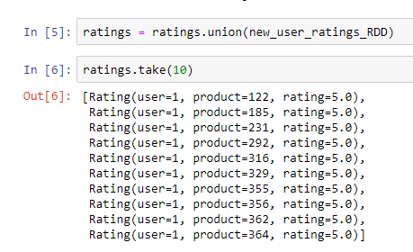
Recommend movies using ALS

Slide 26
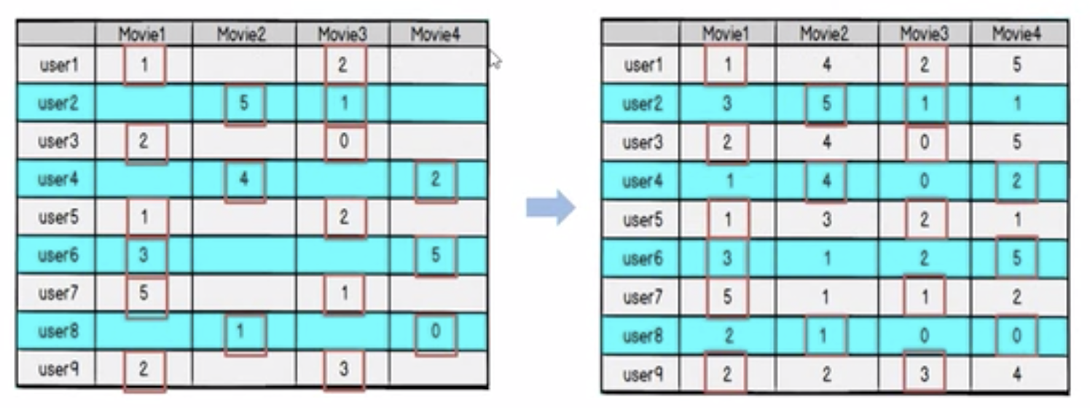
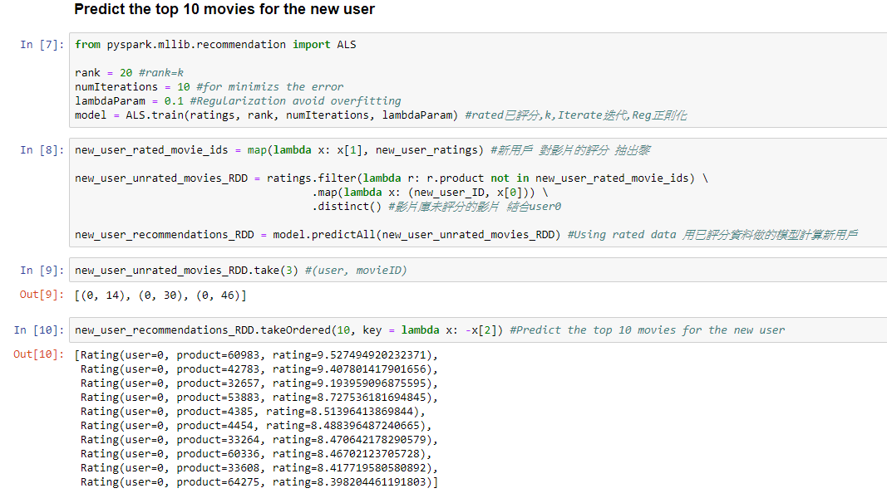
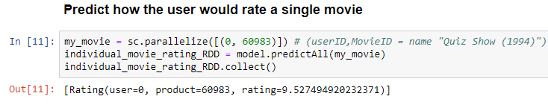
Recommend movies using ALS
K=Implicit factor

Slide 27
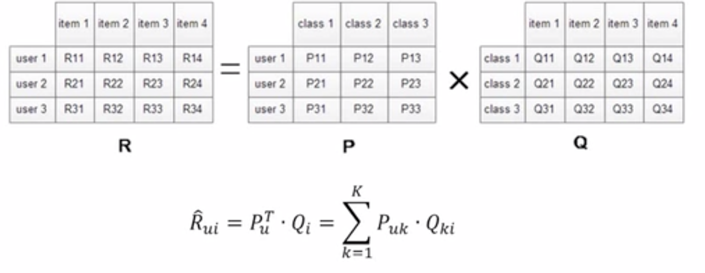
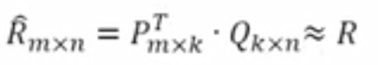
Alternating Least Squares (ALS/SVD++)
Prediction accuracy is improved by considering also implicit feedback, which provides an additional indication of user preferences.
Implicit type: purchase record, surfing record, search mode, mouse movement, etc.

Slide 28
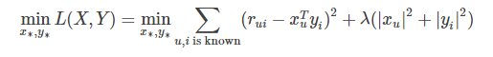
Alternating Least Squares (ALS/SVD++)
Flow:
Initial Q0 for Q, (can be 0 or mean value)
Fix Q0 value, calculate P0
Fix P0 value, calculate Q1
Fix Q1 value, calculate P1
Iterate above steps
Until cost function/ loss factor C decreased (Predicted deviation) (Iteratation limitation )
Notes:
https://www.bilibili.com/video/av52890357/?p=35
https://zhuanlan.zhihu.com/p/24220475
协同过滤(ALS)算法介绍及Spark MLlib调用实例(Scala/Java/Python)
https://blog.csdn.net/oucpowerman/article/details/49847979
矩阵分解模型（1）：ALS学习算法

Slide 29
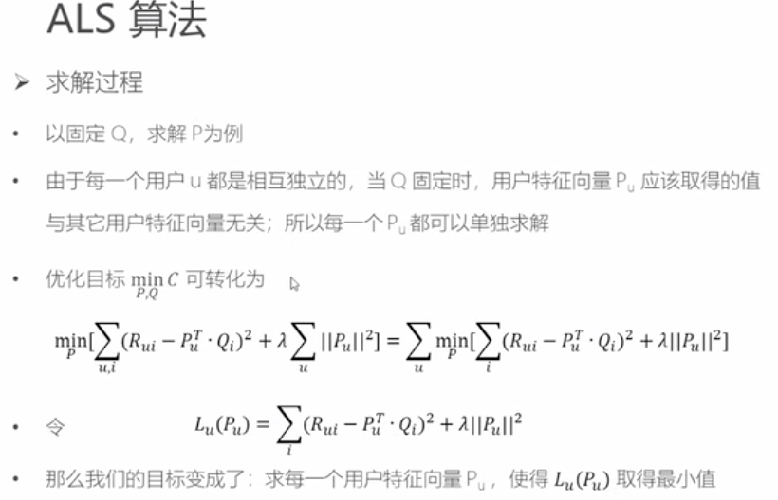
ALS

Slide 30
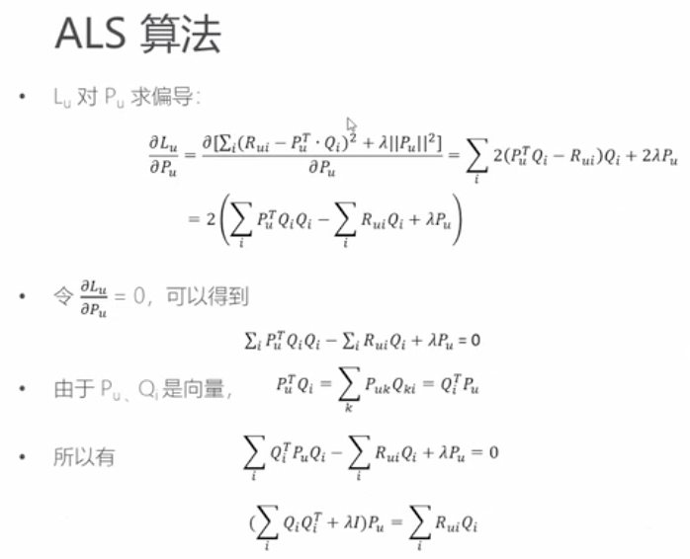
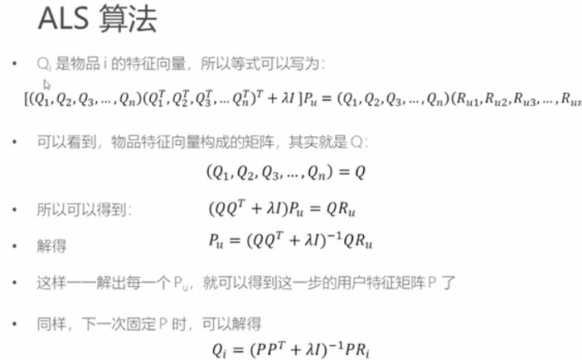
ALS

Slide 31
The End Recommendation System
6th Aug 2019
Kuan Sao I

